Slide 1
TEAM - MF
PROBEM STATEMENT - 2
Build a web-application which is able to load images and classify the segmented objects into waste types. Apossible use case here is for a residential society to measure, track and encourage proper waste segregation.Other use cases for the web application are welcome. Use pre-trained vision models for classification and/orsegmentation and use existing image datasets. The application must have the ability to load and saveimages, provide segmentation of classification results and save them too. The application must have adashboard to provide overall descriptive statistics, such as average percent of waste types, number of wastetypes detected etc. Your app architecture should make suitable architectural and database considerationsfor the stored images along with the segmented predictions.

Slide 2
Problem statement 2
Describe briefly your usecase that solves the PS
- We were aiming to solve the
Describe briefly the user story that you have implemented.
-We want to use a web application to efficiently manage waste segregation by loading images of waste items, automatically classifying them into different waste types, and saving the segmented predictions along with descriptive statistics for tracking purposes.
List the contributions of both team members. Manas contributed the Front-End part.
Fareeha contributed the Back-End part.

Slide 3
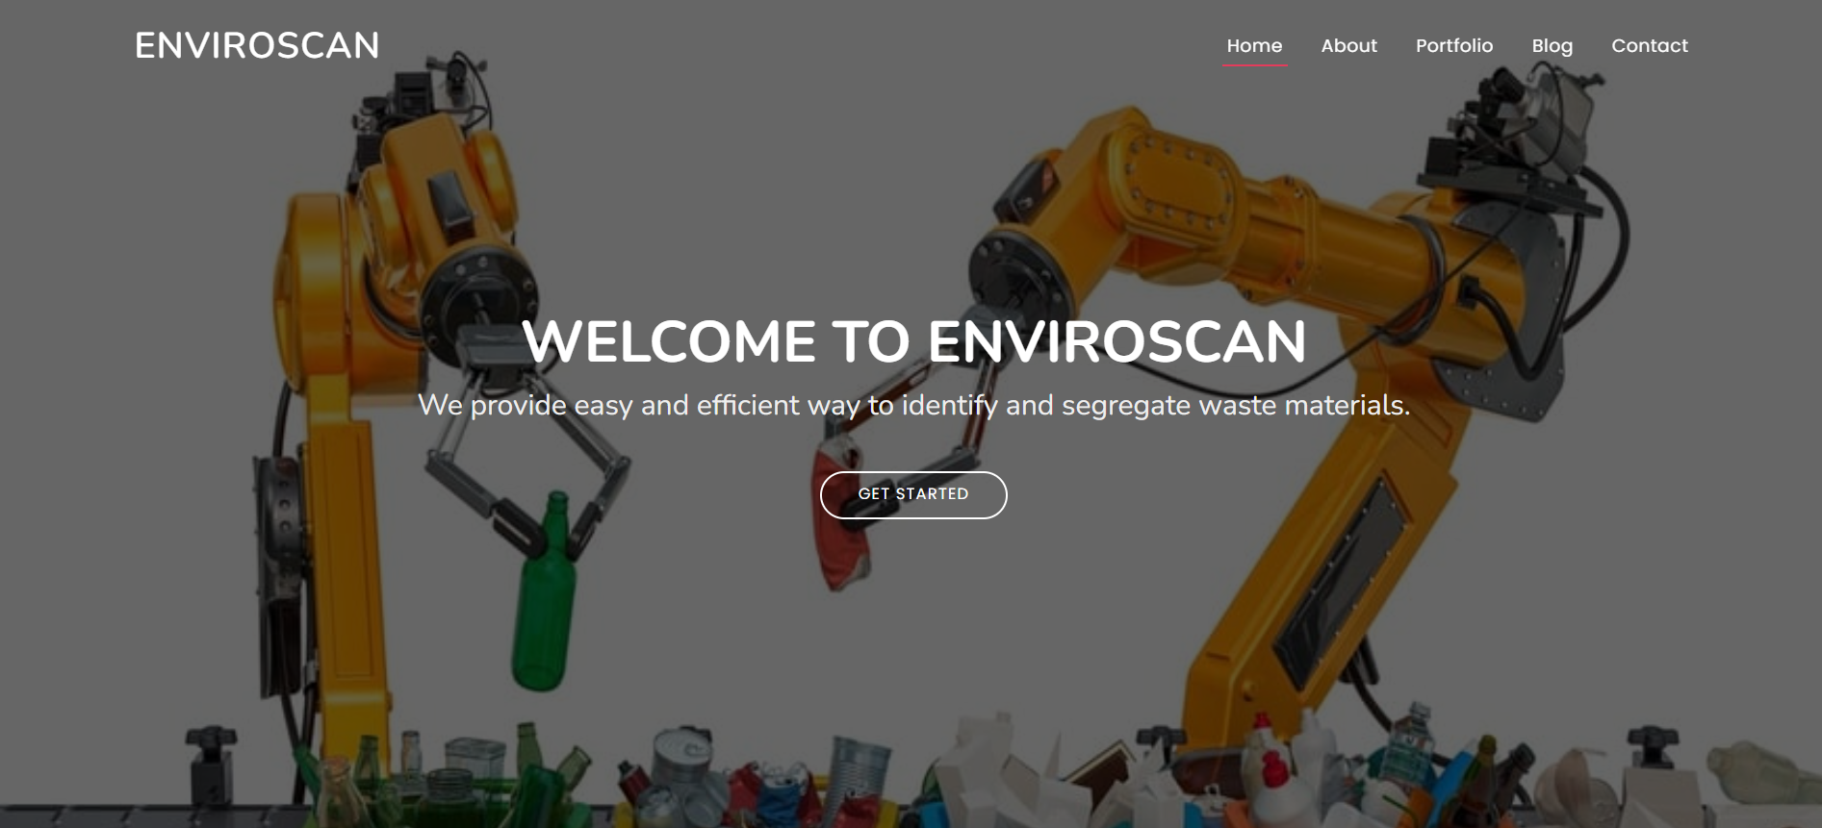
Screenshots

Slide 4
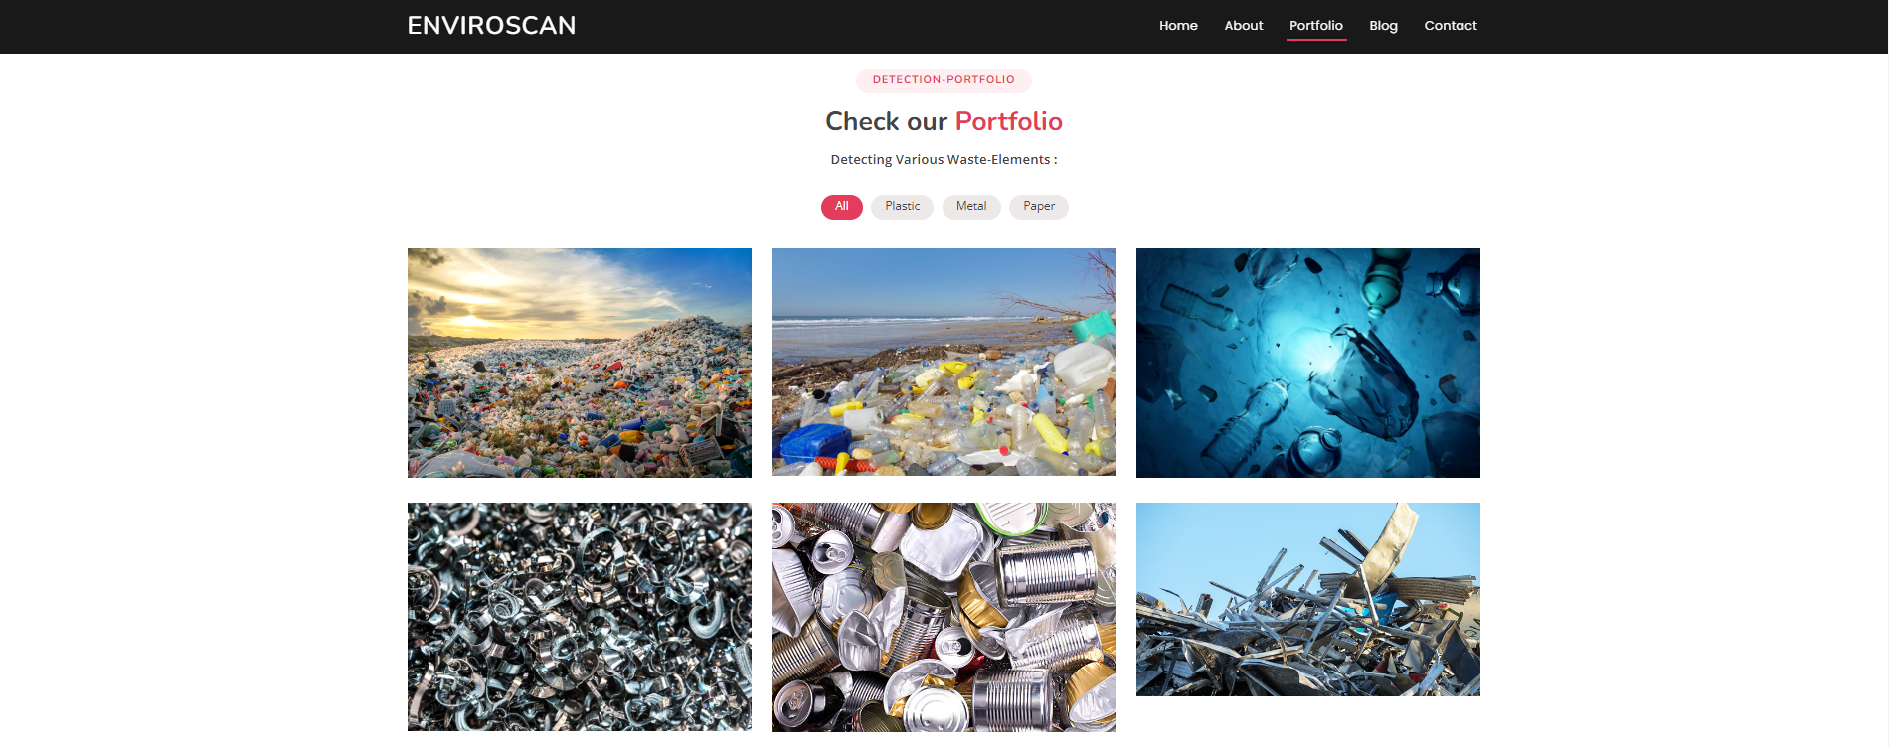

Slide 5
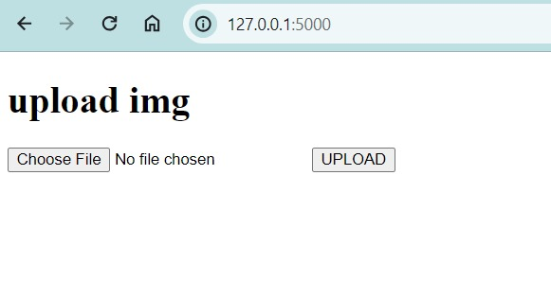
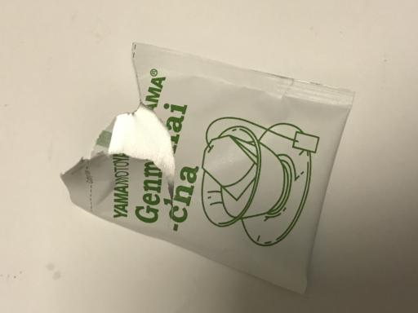
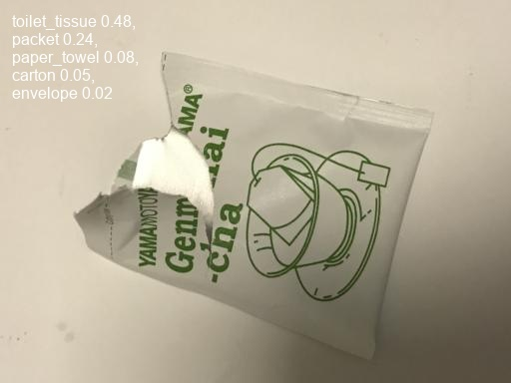

Slide 6
Outlook
How do visualize your solution
- We were aiming for seamless integration of Flask & Django which would help us classify different types of waste.
We could have implemented the chatbot feature which would provide info to users about waste-management techniques.
Gamification would improve the UI-experience.
Ideas that you were not able to implement
Front-end , Back-end connectivity
Gamification
Stats
Unfinished features
Front-end , Back-end connectivity
Gamification
Stats

